Slide 1
HW1
邱弘毅 卓泉源

Slide 2
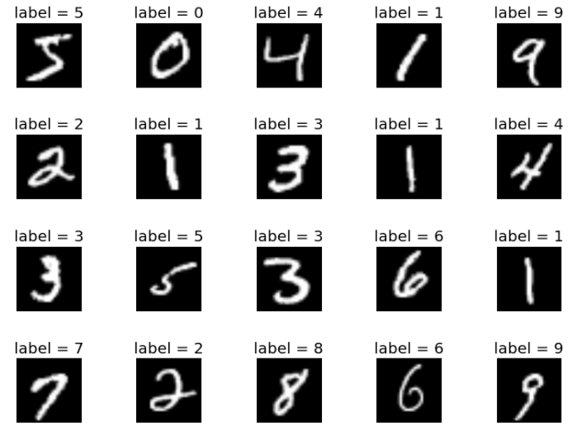
MNIST

Slide 3
Facts
55000 training image
10000 testing image

Slide 4
Input & output
Input dimension
784 (28 * 28)
Output dimension
10 (0, 1, 2, 3 ….. 9)

Slide 5
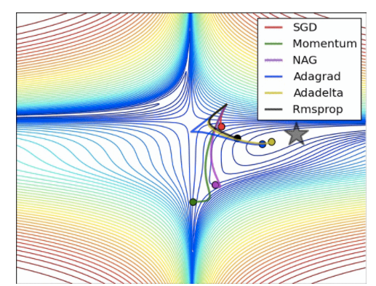

Gradient descent & Batch size

Slide 6


Loss
Cross entropy
How to implement?
P = [0.1, 0.2, 0.5, 0.2]
Q = [0.2, 0.3, 0.4, 0.1]
$Σ$y * tf.log(prediction)

Slide 7
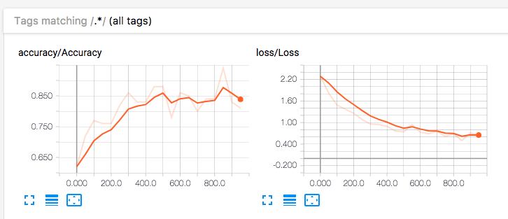
Tensorboard

Slide 8
Criteria
Accuracy > 0.85
Report

